Slide 1

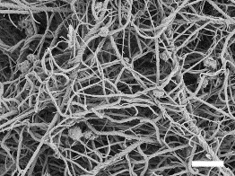
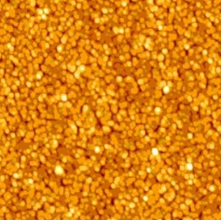
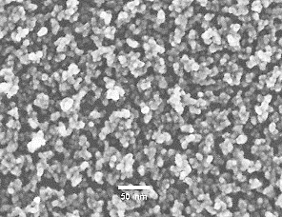
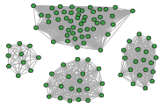
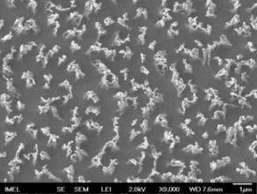
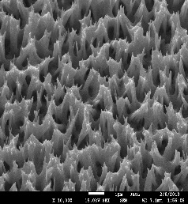
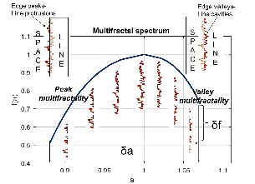
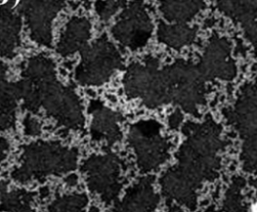

Complexity in Nanotechnology
Vassilios Constantoudis
Institute of Nanoscience and Nanotechnology, NCSR Demokritos, Agia Paraskevi, Greece
Nanometrisis p.c., Agia Paraskevi, 153 41, Greece
NSC2022
1

Slide 2
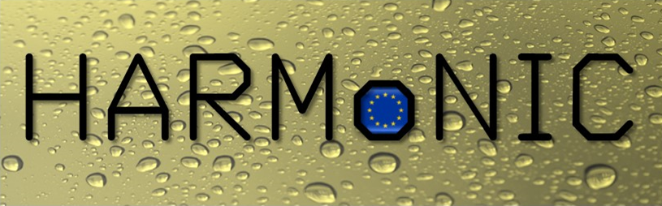



In collaboration with:
Projects
A. Arapis
M. Chatzigeorgiou
A. Kondi
G. Papavieros
D. Nioras
E. Makarona
E. Gogolides
HierARchical Multiscale NanoInterfaces for enhanced Condensation processes
H2020-FETOPEN-2016-2017
Plasma nanotechnology
Traceable 3D nanometrology
A. Milionis
C.W. Edmond Lam
D. Poulikakos
Laboratory of Thermodynamics in
Emerging Technologies
CarbyneSense
‘Carbyne Films: Synthesis of a New Class of Carbon Allotrope and Novel Applications in Sensors and Biosensors

Slide 3
Outline
What is nanotechnology
What is complexity in materials
Why we need complexity in nanotechnology
Characterization of nanocomplexity
Conventional approaches
Symmetry-based approach and applications
Entropy-based approach and applications
Chaos-based approach and applications
Summary
Introduction
Previous work
New ideas
and applications
Summary

Slide 4
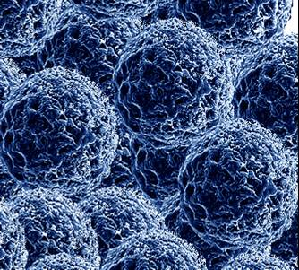
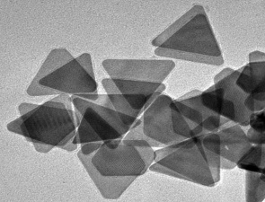
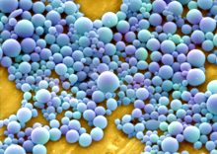
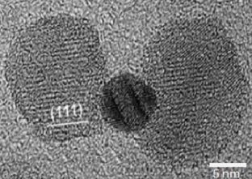
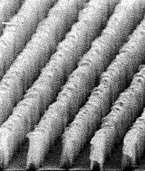
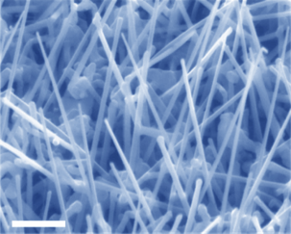
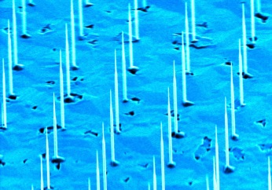
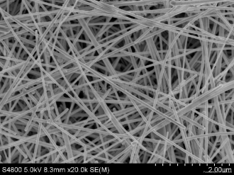
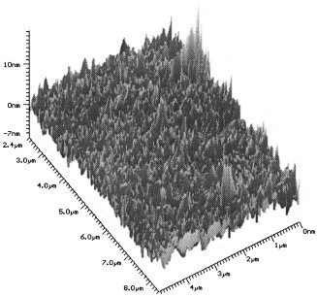
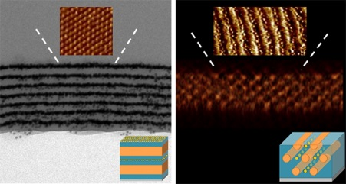
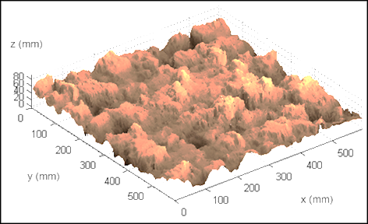
introduction
What is nanotechnology - fundamentals
Nanotechnology: the design, manufacturing, characterization and performance of devices and systems enabled by embedded structures with at least one dimension <100nm (nanostructures)
Nanoparticles (3D nanostructures)
Nanowires - Nanopillars (2D nanostructures)
Thin films(1D nanostructures)

Slide 5
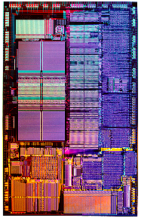
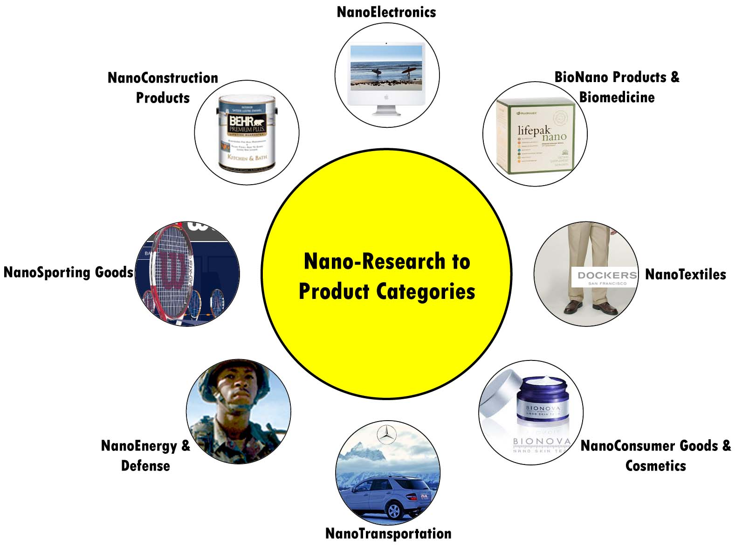

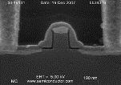
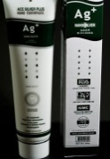
introduction
What is nanotechnology - nanoproducts
More than 10.000 nanotechnology products
in market (https://product.statnano.com/)

Slide 6
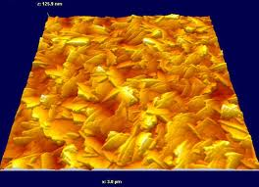
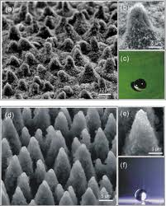
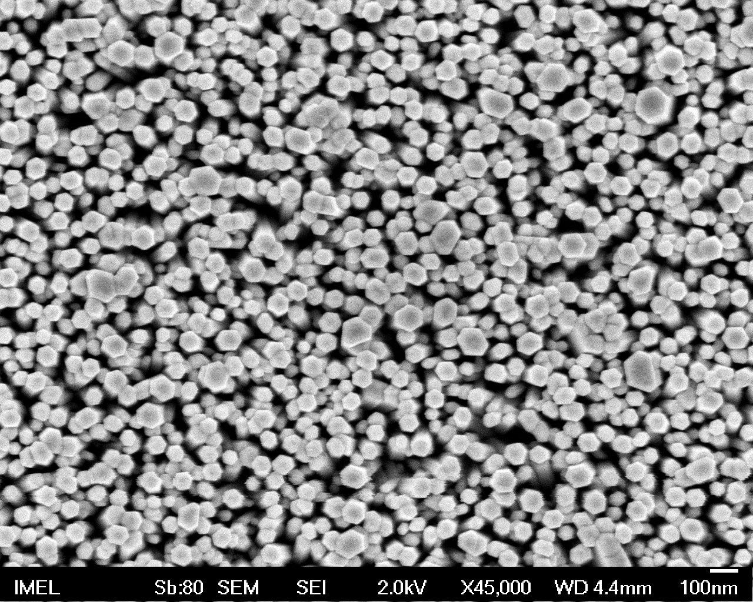
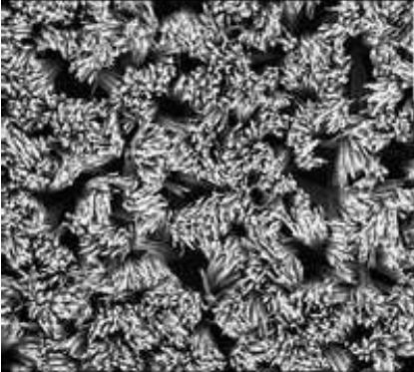
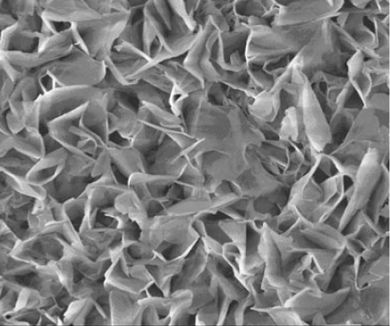
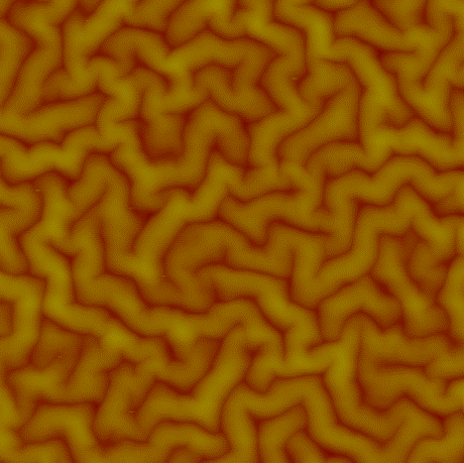
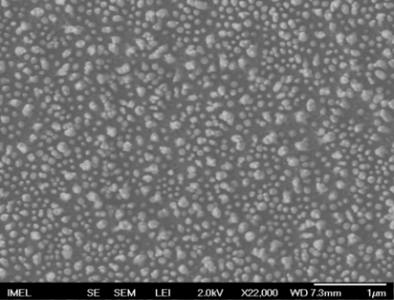
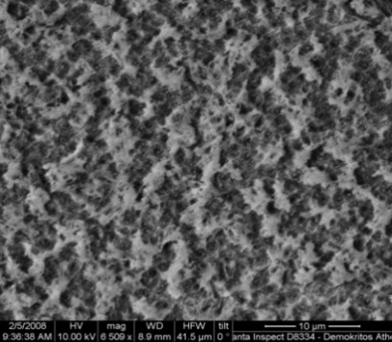
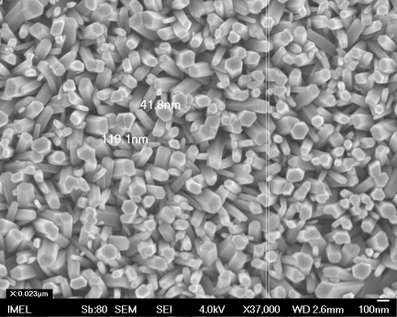

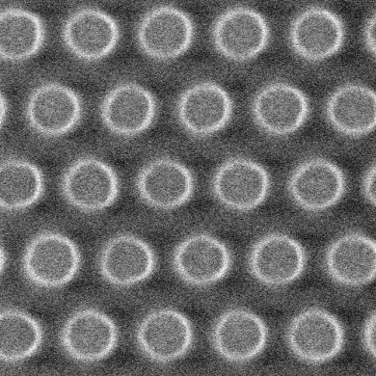
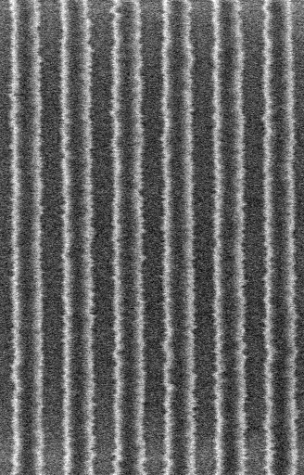
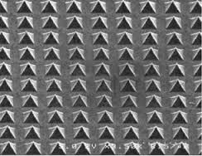
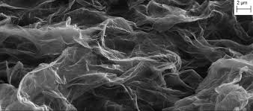
introduction
What is nanotechnology – the great enablers
1st : Explosion of nanofabrication
techniques
2nd : Tremendous advances in
microscopy (resolution, modules)
A flood of images with a vast variety of nanostructure geometries
500nm
1000nm

Slide 7
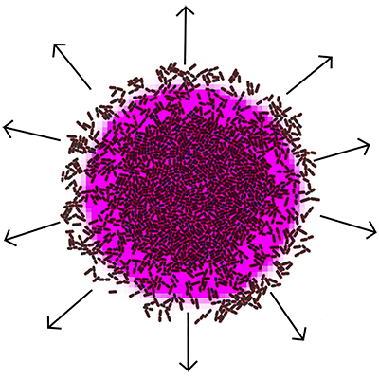
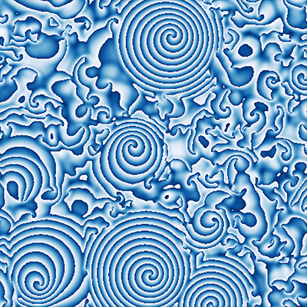
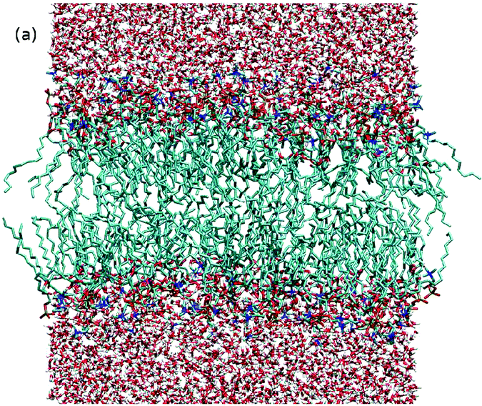
What is complexity in materials
Microscopic dynamics
(atomic, molecular processes)
Statistical
Macroscopic phenomena
and material properties
mechanics
Statistical mechanics deals with systems in thermodynamic equilibrium
What about non-equilibrium systems??
Non-equilibrium statistical processes
Complex spatiotemporal structures
Complexity : hierarchical behaviour,
broken symmetries (between order and chaos),
scaling, nonlinearity, emergence, self-organization, adaptation, long-range correlations,…
Complexity in physics, chemistry, biology, ecology, city and earth science, astronomy,…
Complexity is a language of interdisciplinary concepts and methods

Slide 8
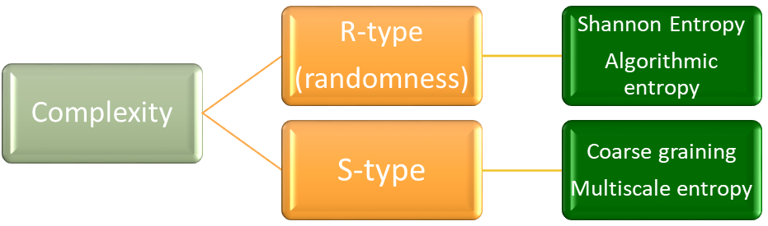
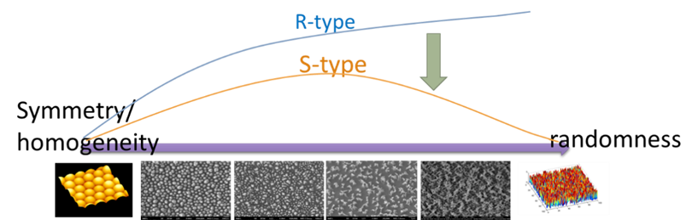
What is complexity in materials
Complexity vs randomness

Slide 9
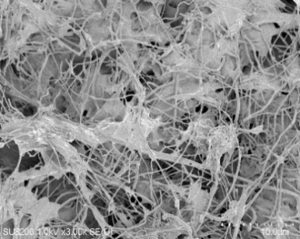
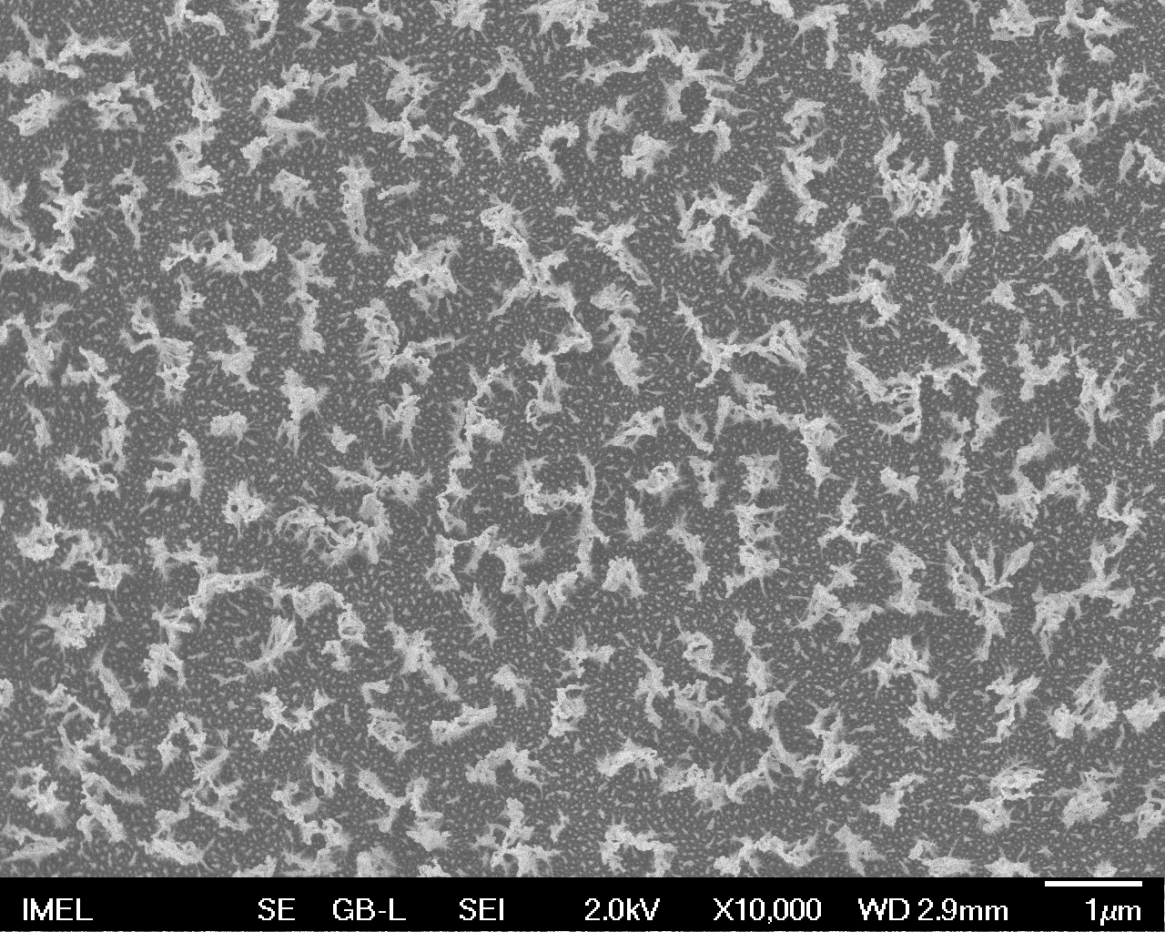
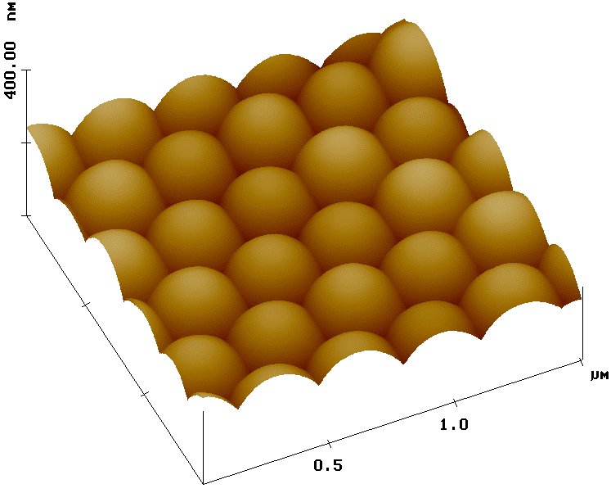
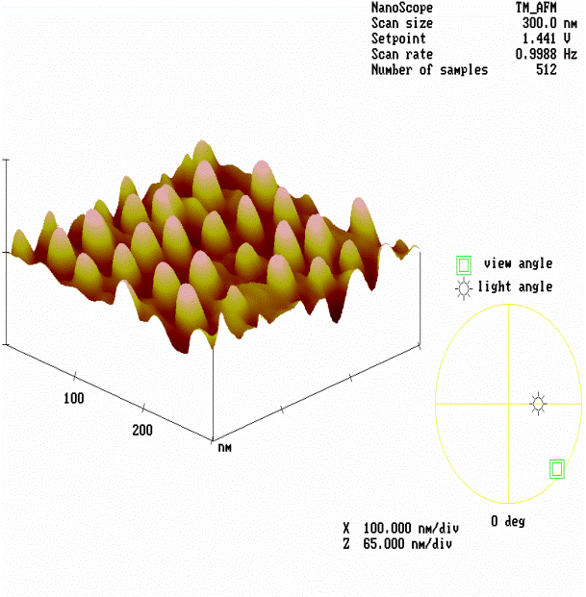
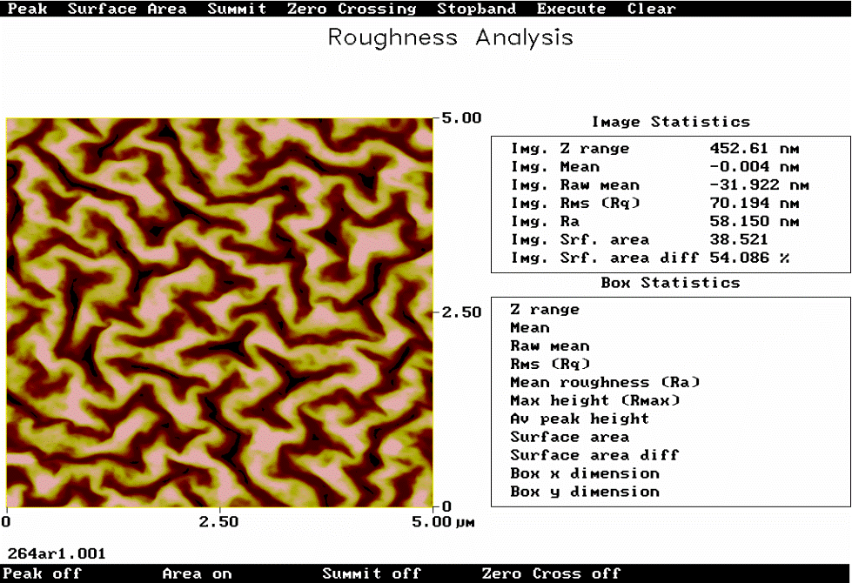
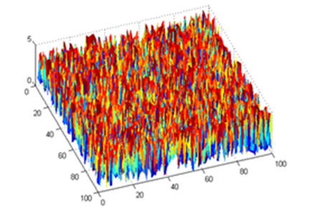
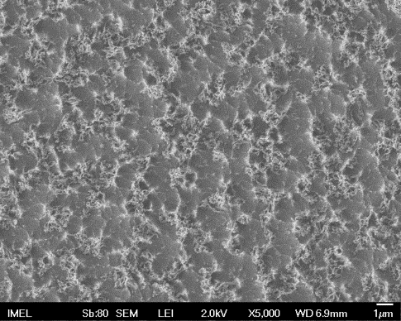
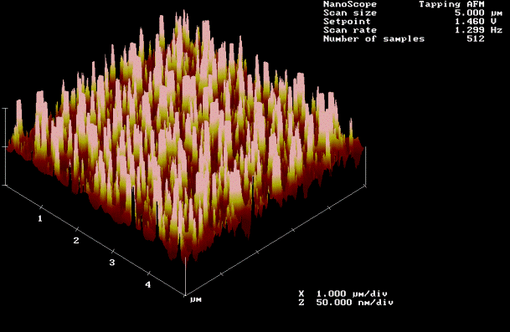

Why do we need complexity in nanotechnology
Nanostructures are the output of non-equilibrium processes
Nanomorphologies lie between fully order and fully randomness
Physicochemical properties of nanostructures depend strongly on their morphologies
Nanostructured surfaces
Fully ordered
Fully random
Build the language to communicate with nanoworld complexity
The grand challenge : Quantify nanocomplexity inspired by complexity toolset

Slide 10


Characterization of nanocomplexity: Previous approaches
Surface roughness – Texture morphologies
Non-typical roughness
Nanoparticle metrology – Discrete structures
No clear definition of
structures
Fractal Approach – Scaling hypothesis
Limited fractal behavior
Not to be rejected BUT to be further advanced and integrated !!!

Slide 11
Characterization of nanocomplexity – novel approaches
Some new ideas based on concepts inspired by complexity science
Statistical/average symmetry and broken symmetries
Information entropy
Chaos and unstable dynamics
Complex networks
Hierarchical structures
…

Slide 12
1st Idea : Symmetry-based Approach
Nanostructure Complexity => deviation from perfect symmetry
Implementation steps:
Detect and Quantify symmetry (translational, rotational, scaling)
2. Characterize deviations from perfect symmetry
Focus on translational and scaling symmetry
A. Translational symmetry (periodic structures)
B. Scaling symmetry (fractal structures)
=
=
V.C. et al. Micro Nano Engineering 2019

Slide 13
1st Idea : A Symmetry-based Approach
Translational symmetry
Fourier transform
(Power Spectral Density, PSD)
=
How do we quantify it and deviations ?
Period λ
Disorder parameter
λ
?
Disorder parameter ω_{d} : Inverse of the FWHM of the Power Spectral Density of nanostructured surfaces normalized to period
V.C. et al. MNE2019, D. Kotziambasis et al. PPP2010
Translational disorder (t-disorder) => ω_{d}

Slide 14





1st Idea : A Symmetry-based Approach
Scaling symmetry
Height-height correlation function (Variogram)
Fractal dimension D_{F}
=
D_{F}
D_{F}
How do we quantify it and deviations ?
Multifractal spectrum
Multifractality δf
δf
Scaling disorder (s-disorder) => δf

Slide 15
A Symmetry-based Approach : Application 1
Surfaces: Metal Oxide (CuO) nanostructures from Hydrothermal Growth vs. rotation speed (rpm) and lab
Scanning Electron Microscope images
Disorder plane
Disorder plane shows the type and amount of symmetry deviations of surfaces
Reveals the disorder effects of experimental conditions
V.C. et al. Micro Nano Engineering 2022

Slide 16




A Symmetry-based Approach : Application 2
Surface disorder and preferential capture of cancer cells
Surfaces: PMMA plates after oxygen plasma etching for various times
Etching time
More surface disorder =>
more preferential capture of
cancer cells
A. Kanioura, V.C. et al. Colloids
and Surfaces B: Biointerfaces 2019

Slide 17



Symmetry-based Approach : Limitations
The disorder parameters monotonically increase with randomness => not proper metric of complexity
Need for a quantity with minima at both full order/homogeneity and randomness and maximum in between
Entropy S
complexity
Symmetry/
homogeneity
randomness

Slide 18

2nd Idea : An Entropy-based Approach
From exact to average symmetry
Nanostructured surfaces as complex systems with information content
Complexity => amount of deviation from average/statistical symmetry
Complexity => maximum information => entropy-based metrics
Quantify nanocomplexity through entropy-based metrics characterizing deviation from average symmetry
R. Alamino J. Phys. A 2015, 2017

Slide 19










2nd Idea : An Entropy-based Approach
Implementation in 3 steps :
1st step: Calculate the local averages and generate the “mass” field m(x,y) at each scale r
r
$$I= \left\{x−r, x,x+r\right\}$$
Mass fields for increasing r
$$J= \left\{y−r, y,y+r\right\}$$
r
$$m\left(x,y;r\right)=\frac{1}{9}\sum_{iεI}{\sum_{jεJ}{z\left(i,j\right)}}$$
2nd step: At each scale r, quantify the field homogeneity/hetetogeneity (information content) through the entropy E(r) of the normalized mass distributions λ(m|r)
E$\left(r\right)=−\sum_{m}{λ\left(m | r\right)lnλ(m|r))}$
3rd step: Average over all scale entropies and get the complexity (AC) of the surface
AC = < E(r) >_{r}

Slide 20

2nd Idea : An Entropy-based Approach
Complexity as average over multiscale entropy has been designed to exhibit maximum between full symmetry (homogeneity) and full randomness
complex
Entropy
Maximum complexity
random
periodic
Minimum complexity
Scale r

Slide 21


Entropy-based Approach - Applications
randomness
maximum
homogeneity

Slide 22


Entropy-based Approach - Applications
complexity
maximum
Correlation length (nm)

Slide 23


Entropy-based Approach - Applications

Slide 24




Entropy-based Approach - Applications
1.

Slide 25


Entropy-based Approach - Applications
2. Al surfaces after wet etching and boiling in CuCl₂ or FeCl₃
Etching with CuCl₂
Etching with FeCl₃
Higher complexity => larger heat transfer coefficient

Slide 26



3rd Idea : A Chaos-based Approach
Chaos : sensitivity to initial conditions
Microscopy imaging: magnification
Idea : Use of chaos as a “dynamical microscope” of spatial complexity

Slide 27





3rd Idea : A Chaos-based Approach
Chaos : Stretching and folding of trajectories in phase space => sensitivity to initial conditions in bound systems
Invertible
Area preserving
Ergodic
Mixing
…
High frequencies enhancement
Increase of discontinuities

Slide 28
3rd Idea : A Chaos-based Approach
The key idea
chaos
stretching
High frequencies
folding
discontinuities
Distance from randomness
Distance from uniformity
Spatial complexity
How?
Quantification through Fourier analysis

Slide 29




3rd Idea : A Chaos-based Approach
Chaos-based complexity measure

Slide 30


3rd Idea : A Chaos-based Approach
  Explanation and Validation
Folding =>
discontinuities
Stretching =>
randomization

Slide 31


  Simulated surfaces/images
Computer generated rough self-affine surfaces with controlled correlation length and roughness exponent a(=1-Fractal Dimension)
SD_{b} vs. correlation length and roughness exponent
randomness
smoothness
Strong fractality
SD_{b} is maximized at ξ=50 pix and α tending to 1

Slide 32

  Experimental surfaces/images
Top-down SEM images of aluminum etched in hydrochloric acid for different durations a) 5 minutes in HCl, Magnitude x2000, SEI sensor b) 7 minutes in HCl, Magnitude x2000, LEI sensor c) 8 minutes HCl Magnitude x2000, LEI sensor d) 15 minutes in HCl, Magnitude x2000, LEI sensor.
5 min
7 min
8 min
15 min
SD_{b} is maximized at t=8min
Maximization of water condensation

Slide 33
Conclusions
Most nanosurfaces exhibit complex morphologies between order and randomness
Current approaches do not provide a concise framework for the characterization of nanocomplexity
Basic idea: Inspiration from complexity science methods
Proposal 1: A symmetry-based approach characterizes nanocomplexity with the deviation from perfect symmetry (translational => disorder parameter, scaling => multifractality)
Proposal 2: An entropy-based approach quantifies surface complexity as the average over multiscale entropy
Proposal 3: A chaos-based approach uses chaotic mixing to characterize nanocomplexity
Applications in synthesized and real data shown promising results
Higher surface disorder seems to link to more preferential capture of cancer cells
Higher entropy and chaos-based complexity leads to larger heat transfer coefficient and water condensation
Future work 1: Further understanding of the relationship of three approaches and their areas of applications
Future work 2: More theoretical and experimental investigation of the links of nanocomplexity with
fabrication parameters and surface properties

Slide 34

Thank you very much!!!
Thank you very much!
v.constantoudis@inn.demokritos.gr

